Slide 1
D. PLCC Beginning Languages
Fall 2020

Slide 2
Some Terms
defined language
the language to be processed
defining language
the language to use for the processor
"processor"?
compiler?
interpreter?
Remember our diagram.

Slide 3
Interpreters vs. Compilers
Any system that does not translate code in the defined language down to machine code does interpretation.
Any system that transforms code in the defined language into another form before processing it does compilation.
Which languages are purely one or the other?

Slide 4
V0
We start our V-series with V0, a language that recognizes simple expressions written in a prefix, function-calling style
5
blah
+(9,5)
-(13,blah,89)
-(+(1,2),+(3,4))
add1(blah)
sub1(15)
+(+(+(+(0))))
We will restrict
+ and – to two
parameters in V1.

Slide 5
What it ain't
V0 does not
know how to store variable values => no Environment
evaluate expressions
Its legal stuff is
integer constants
identifiers
+( arg₁, arg₂, …, arg_{n} ) and –(arg₁, arg₂, …, arg_{n} )
Any number of operands
add1( arg ) and sub1(arg )
Just one operand, but checked at run-time

Slide 6
It just displays the entered expression!

Slide 7
About Infix and Prefix
a tangent:
add34.c
#include <stdio.h>
int add( int a, int b ) {
return a + b;
}
int main() {
int x = 3 + 4; /* infix notation */
printf( "%d\n", x );
int y = add( 3, 4 ); /* prefix notation, with lots of punctuation */
printf( "%d\n", y );
return 0;
}
$ gcc add34.c
$ ./a.out
7
7

Slide 8
About Infix and Prefix
a tangent:
$ racket
Welcome to Racket v7.9 [bc].
> (+ 3 4) ; prefix notation, with a little bit of punctuation
7
> ^D
$ ghci
GHCi, version 8.0.2: http://www.haskell.org/ghc/ :? for help
Prelude> 3 + 4 -- infix notation
7
Prelude> (+) 3 4 -- prefix notation trick
7
Prelude> let add x y = x + y
Prelude> add 3 4 -- prefix notation with no extra punctuation
7
Prelude> ^D
Leaving GHCi.

Slide 9
The Tokens
skip WHITESPACE '\s+'
skip COMMENT '%.*'
LPAREN '\('
RPAREN '\)'
COMMA ','
ADDOP '\+'
SUBOP '\-'
ADD1OP 'add1'
SUB1OP 'sub1'
VAR '[A-Za-z]\w*'
LIT '\d+'

Slide 10
The Grammar
<program> ::= <exp>
<exp>:LitExp ::= <LIT>
<exp>:VarExp ::= <VAR>
<exp>:PrimAppExp ::= <prim> LPAREN <operands> RPAREN
<operands> **= <exp> +COMMA
<prim>:AddPrim ::= ADDOP
<prim>:SubPrim ::= SUBOP
<prim>:Add1Prim ::= ADD1OP
<prim>:Sub1Prim ::= SUB1OP

Slide 11
The Semantic Stuff
See v0.plcc.
Note that, when the goal is to basically output what was input, a lot of the code seems rather silly.
Demo

Slide 12
V0 Example from class: +(-(3,2),a)
:Program
:PrimAppExp
<program> ::= <exp>
<exp>:PrimAppExp ::=
<prim> '(' <operands> ')'
<operands> **= <exp> +','
<prim>:AddPrim ::= '+'
<prim>:SubPrim ::= '-'
<exp>:LitExp ::= <LIT>
<exp>:VarExp ::= <VAR>
:AddPrim
:Operands
:SubPrim
:PrimAppExp
:Operands
:VarExp
:LitExp
:LitExp
:Token
2
:Token
:Token
3
a

Slide 13
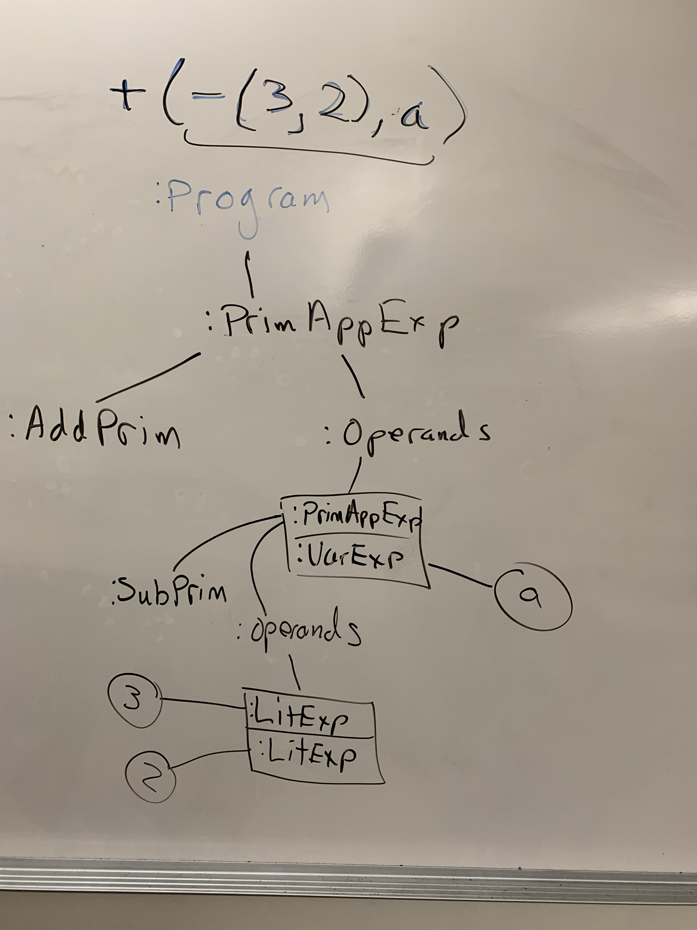
V0 Example from class: +(-(3,2),a)
:Program
:PrimAppExp
<program> ::= <exp>
<exp>:PrimAppExp ::=
<prim> '(' <operands> ')'
<operands> **= <exp> +','
<prim>:AddPrim ::= '+'
<prim>:SubPrim ::= '-'
<exp>:LitExp ::= <LIT>
<exp>:VarExp ::= <VAR>
:AddPrim
:Operands
:SubPrim
:PrimAppExp
:Operands
:VarExp
:LitExp
:LitExp
:Token
2
:Token
:Token
3
a

Slide 14
V1: V0 + Evaluation
We can now apply the primitive functions to literals.
If we pre-load some bindings into an environment node, we can put variables in the function calls, too.
Recall grammar
<program> ::= <exp>
<exp>:LitExp ::= <LIT>
<exp>:VarExp ::= <VAR>
<exp>:PrimAppExp ::= <prim> '(' <operands> ')'
<operands> **= <exp> +','
<prim>:AddPrim ::= ADDOP
<prim>:SubPrim ::= SUBOP
<prim>:Add1Prim ::= ADD1OP
<prim>:Sub1Prim ::= SUB1OP
To do
Create an EnvNode in Program
Add abstract eval() method to Exp
Add abstract apply(Val[]) method to Prim
because PrimAppExp has the operands, not Prim

Slide 15
Solution and Example
V1's Materials in Handouts
There are no changes to the grammar; it's all semantics.
Shows code realizations of all changes mentioned on the previous slide.
(Old toString methods left in just for reference.)
Note that each primitive specifies its argument count.
A RuntimeException is thrown if the count is wrong.

Slide 16
How to Add "IF"
The current language V1 is currently functional.
Execution consists of evaluating applications of (primitive) functions.
There are no side effects – program state never changes.
Imperative style if, with optional else part, will not work.
An expression must always have a result.
We take instead as an inspiration the C "if expression":
int w = x ? y : z;
Our syntax:
if x then y else z

Slide 17
Solution and Example
V2 additions
New tokens, and then a new grammar rule: <exp>:IfExp ::= IF <exp>test THEN <exp>thenPart ELSE <exp>elsePart
In class IfExp:
public Val eval( Env env ) {
return test.eval( env ).isTrue() ?
thenPart.eval( env ) : elsePart.eval( env );
}
In environment class Val:
public boolean isTrue() { return value != 0; }
the classic C semantics

